Slide 1
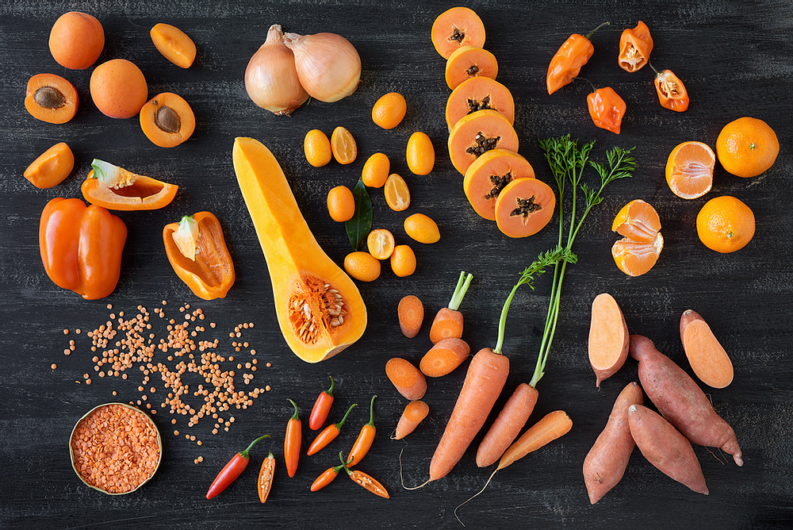

Ordinal Logistic Regression
2021 | ANDRÉ NÜßLEIN, DOLEV ILLOUZ

Slide 2
Modelling beta-carotene plasma levels
Motivation
Beta-carotene is found in food and dietary supplements.
Has been shown to be associated with increased cancer risk.
Prior Model Development
Leverage 315 patients’ personal and dietary traits such as, age, smoking status, etc.
Previously: linear and logistic regression approaches were utilized.
Found that many of these variables can predict the beta-carotene
plasma concentration; However, extreme values greatly affect the results.

Slide 3
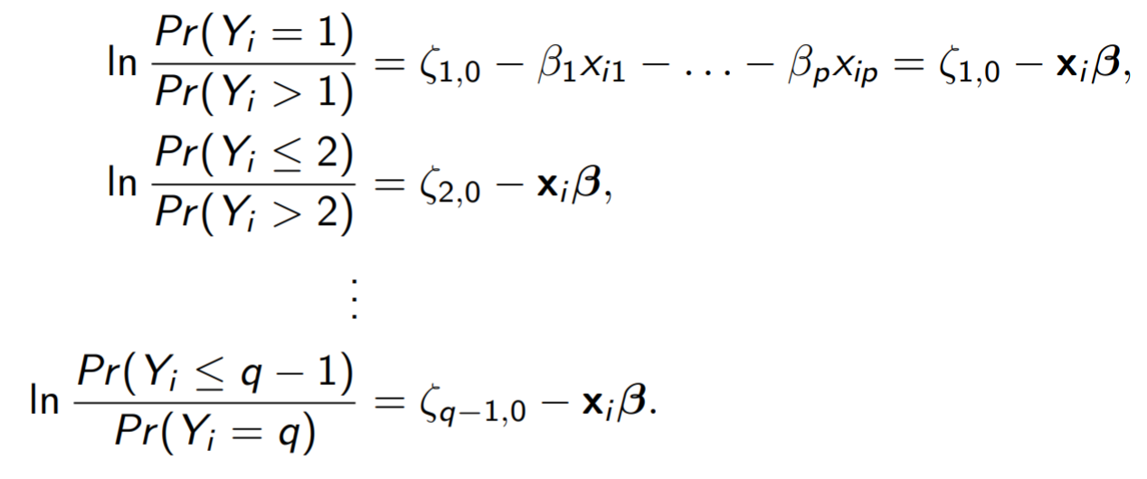

Modelling beta-carotene plasma levels
Current models separate groups into 4 categories.
Ordinal Logistic Models
Have an output, $Y_{i}$, that has a logical
order and is categorical.
Multinomial Logistic Models
No logical ordering in $Y_{i}.$
Hence, OR has no (≤/≥) symbols,
nor are there any ζ variables.

Slide 4

Ordinal Models Tested
AIC
Forwards
Backwards
BIC
Forwards
Backwards
Manual Testing
ANOVA
$R_{adj.}^{2}$ scores

Slide 5
Final Ordinal Model
Parameter | Quetelet | Beta-carotene dietary supplements | Vitamin use (Not often) | Vitamin use (No) | Age | Smoking Status (Former) | Smoking Status (Current) | Sex (Male) | Fiber Intake | Fat Intake
β value | -0.08734 | 0.0001911 | 0.08752 | -0.6925 | 0.02937 | -0.2531 | -0.7355 | -0.7441 | 0.0560 | -0.005504
Categories | Very Low|Low | Low|Moderately High | Moderately High|High
ζ value | -1.926 | -0.6178 | 0.7081

Slide 6
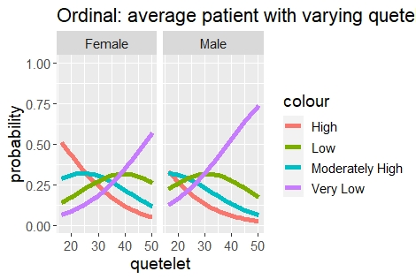
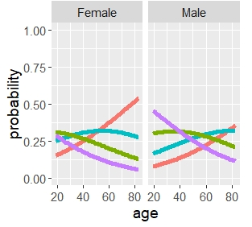
Final Ordinal Model
Figure 1: The probability of belonging to a certain beta-carotene plasma level category for an average individual with varying age and quetelet.

Slide 7
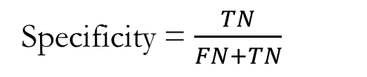
Final Ordinal Model
Predicted
Blood Plasma Category | Very Low | Low | Moderately High | High
Very Low | 44 | 13 | 15 | 8
Low | 33 | 13 | 17 | 15
Moderately High | 18 | 10 | 25 | 24
High | 11 | 5 | 16 | 47
Specificity = $\frac{TN}{FN+TN}$
Actual
Specificity
0.74
0.88
0.80
0.80
True negatives = 44 + 15 + 8 + 18 + 25 + 24 + 11 + 16 + 47 = 208
True and false negatives = 208 + 13 + 10 + 15 = 236
Notes:
.

Slide 8
Final Ordinal Model
Predicted
Blood Plasma Category | Very Low | Low | Moderately High | High
Very Low | 44 | 13 | 15 | 8
Low | 33 | 13 | 17 | 15
Moderately High | 18 | 10 | 25 | 24
High | 11 | 5 | 16 | 47
Precision
42 %
32 %
34 %
50 %
Sensitivity
55 %
17 %
32 %
59 %
Actual
Specificity
74 %
88 %
80 %
80 %
Accuracy = 41 %
AUC = 68 %
Notes:
.

Slide 9
3 Carrots aren’t better than 3 Tangerines...

Slide 10

Multinomial Models Tested
AIC
Forwards
Backwards
BIC
Forwards
Backwards
Manual Testing
ANOVA
$R_{adj.}^{2}$ scores

Slide 11
Final Ordinal Model
Parameter | Quetelet | Beta-carotene dietary supplements | Vitamin use (Not often) | Vitamin use (No) | Age | Smoking Status (Former) | Smoking Status (Current) | Sex (Male) | Fiber Intake | Fat Intake
β value | -0.08734 | 0.0001911 | 0.08752 | -0.6925 | 0.02937 | -0.2531 | -0.7355 | -0.7441 | 0.0560 | -0.005504
Categories | Very Low|Low | Low|Moderately High | Moderately High|High
ζ value | -1.926 | -0.6178 | 0.7081

Slide 12
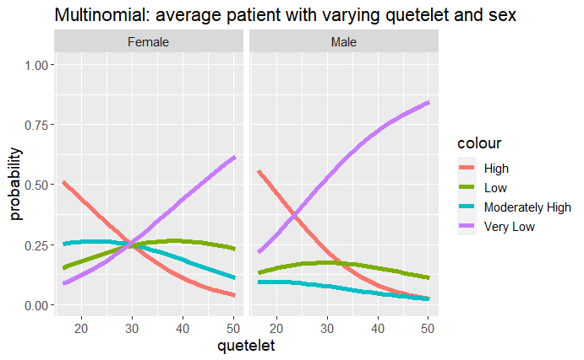
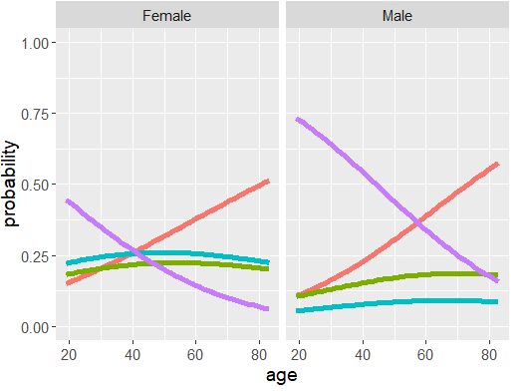
Final Ordinal Model
Figure 2: The probability of belonging to a certain beta-carotene plasma level category for an average individual with varying age and quetelet.

Slide 13
Final Ordinal Model
Predicted
Blood Plasma Category | Very Low | Low | Moderately High | High
Very Low | 46 | 13 | 11 | 10
Low | 27 | 16 | 22 | 13
Moderately High | 17 | 11 | 29 | 20
High | 13 | 4 | 17 | 45
Precision
45 %
36 %
37 %
51 %
Sensitivity
57 %
21 %
38 %
57 %
Actual
Specificity
71 %
88 %
79 %
82 %
Accuracy = 50 %
AUC = 71 %
Notes:
.

Slide 14
3 Carrots aren’t better than 3 Tangerines...
Or are they?

Slide 15
Comparison of Multinomial & Ordinal Models
AUC, specificity, sensitivity, accuracy, & precision.
Specificity
74 %
88 %
80 %
80 %
Sensitivity
55 %
17 %
32 %
59 %
Precision
42 %
32 %
34 %
50 %
Accuracy = 41 %
AUC = 68 %
Ordinal
Specificity
71 %
88 %
79 %
82 %
Sensitivity
57 %
21 %
38 %
57 %
Precision
45 %
36 %
37 %
51 %
Accuracy = 50 %
AUC = 71 %*
Multinomial

Slide 16
Thank you for your attention.

